Slide 1
VISTA Centers for Interdisciplinary Research on Future Energy Solutions
- A major transition
-How can we contribute?

Slide 2
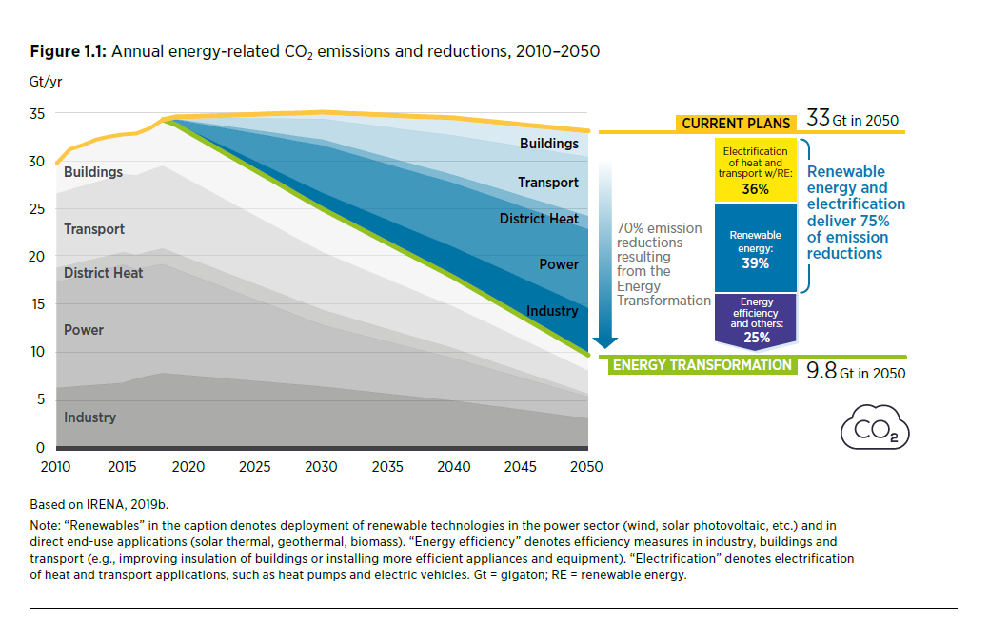
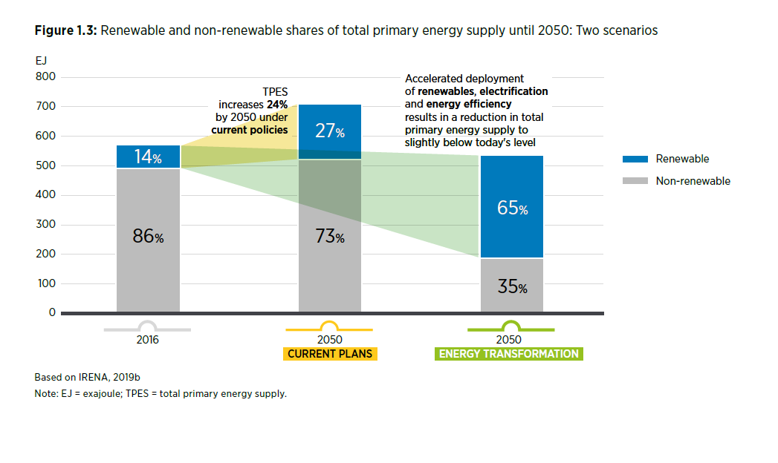
The Global energy transition – and challenge: Significant reduction in CO2 emissions Significant reduction in use of fossil energy sources
The International Renewable Energy Agency

Slide 3
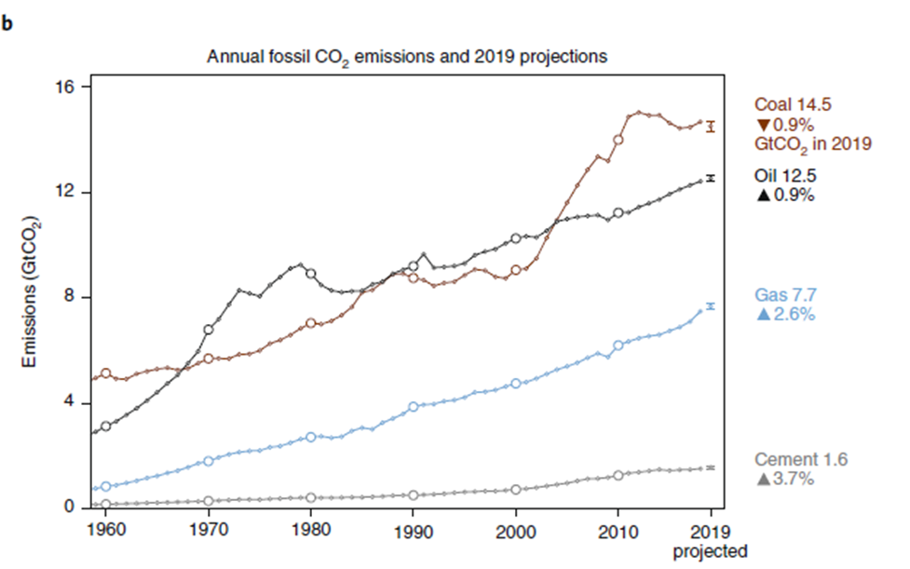
The hard facts (I)
Peters et al 2019: A failure to recognize the factors behind continued emissions growth could limit the world’s ability to shift to a pathway consistent with 1.5 °C or 2 °C of global warming. Continued support for low-carbon technologies needs to be combined with policies directed at phasing out the use of fossil fuels.
Global fossil CO2 emissions showing projections for 2019
Nature Climate Change December 2019

Slide 4
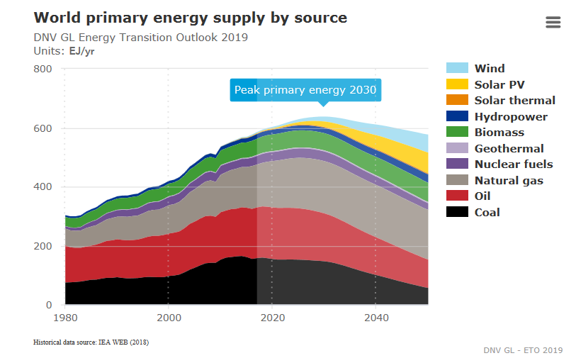
The Global energy transition – the hard facts (II)
Key challenges for Academia:
Supply knowledge to enable the energy sector to:
change to alternative energy solutions
reduce emissions

Slide 5
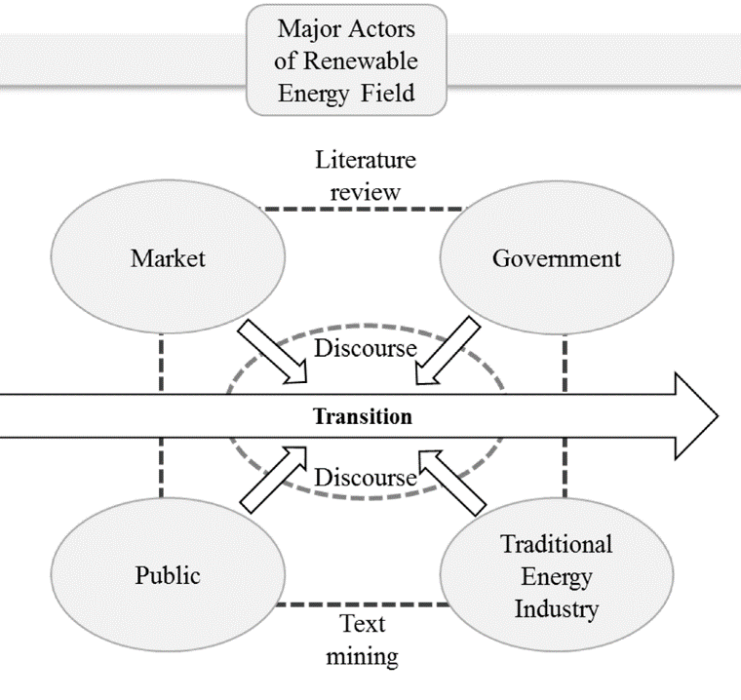
The Energy transition and the Vista-program
Basic research is a fundament for dealing with the climate challenge and the energy transition. However, its impact rests on a useful transformation to solutions
Note: it is in the big companies that new technology is most often developed, they are able to make new discoveries right up to the market
A priority task for the Vista centers is active collaboration with Equinor senior researchers. This emphasizes the translational research approach
Note: Integration of perspectives from social sciences and the humanities into proposed projects are encouraged
Adapted from Sung and Park, 2019

Slide 6
The Energy transition and the Vista-program
In a 2020-2050 perspective:
Fossil resources will remain an important contributor to global energy consumption.
Lower the environmental footprint of fossil fuels production, e.g. field electrification
Develop CCS/CCUS technologies.
In a CO2 neutral society efficient energy storage and transport solutions to meet the intermittency of renewable energy sources, and to secure energy supply beyond the electricity grid
On this background, the aim of the program is to support science that provides fundamental insight in
Basin analysis and efficient resource identification and utilization
Future development solutions
Sustainability, environment and low carbon solutions.

Slide 7
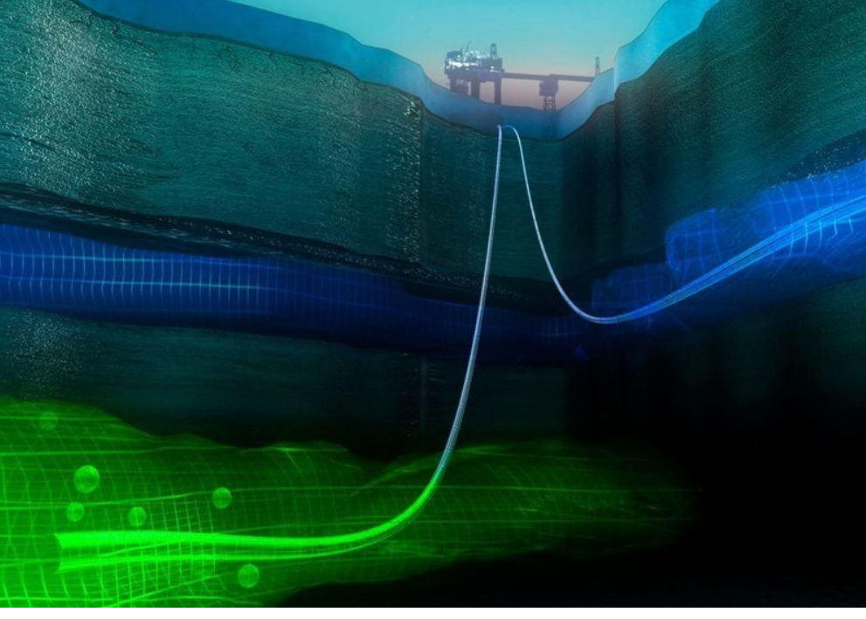
Basin analysis and efficient resource identification and utilization
Quote from the call How can we understand the call
Fundamental insight in rock properties, their chemical and physical interaction with various substances, cracking patterns and pore flow characteristics are essential for
for efficient exploration and production of existing hydrocarbons resources,
for CO2 injection that could be linked to an enhanced recovery (EOR)
for CO2 injection that could be linked to a CCS/CCUS scheme
Such insight builds on a combination and integration of geology, geophysics, geochemistry, petrophysics, geomechanics, production engineering, reservoir engineering and information technology expertise.
Key words porous media - very basic and relevant for CO2 storage as well as for recovery

Slide 8
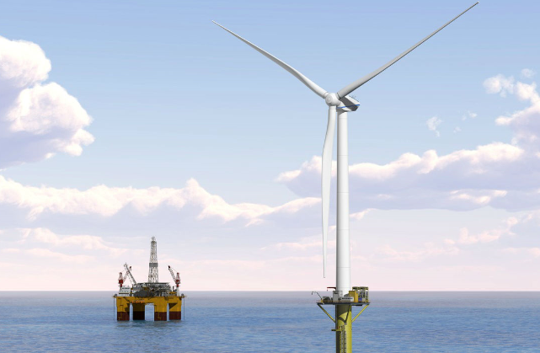
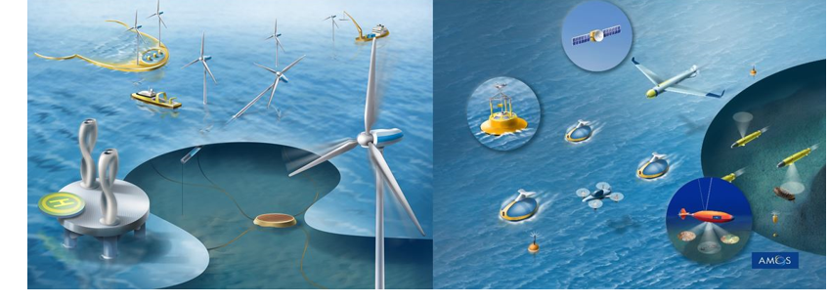
Future development solutions
Quote from the call How can we understand the call
Fundamental insight in process chemistry and physics, combined with electronics and information technology, is required to
Optimize energy efficiency of field operation processes.
Big data processing, augmented reality,
Smart machines and robots,
Robotic software and automation are rapidly evolving fields of research that are key to secure efficient, safe operation of remote installations and factories.
The oil and gas sector accounts for ap 27 % of national emissions. From a national point of view, this is important to bring down.
Knowledge and solutions here are generic for future major marine installations crucial for the implementation and monitoring of complex marine operations. e.g. theme 3
NTNU AMOS - Centre for Autonomous Marine Operations and Systems

Slide 9
Sustainability, environment and low carbon solutions
Quote from the call How can we understand the call
Combined fundamental insight in chemistry, electrochemistry and materials science, as well as process engineering, is required to
develop new, largely improved gas separation solutions in a CCS/CCUS (and EOR with CO2 injection) process scheme.
Fundamental insight in the chemistry, electrochemistry and physics of different options is required to develop
new, largely improved solutions for long-term storage of energy.
A combination of biology, chemistry, physics, climate, electronics and information technology expertise is required to meet these challenges.

Slide 10
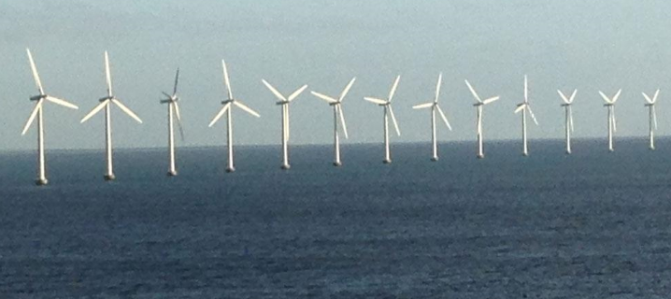
Sustainability, environment and low carbon solutions
Quote from the call How can we understand the call
Fundamental insight in the combined effects of chemicals and drilling/seabed processing equipment on
marine life,
the effect of offshore wind turbines on marine life and bird migration
Key to the development of next generation technologies with lower environmental footprint in a current, 2020-2050 and >2050 perspective.
It is particularly important to understand the dynamic and long-term effects of exploration and energy production on the food web.
A combination of biology, chemistry, physics, climate, electronics and information technology expertise is required to meet these challenges.
NIVA report no. 7391-2019

Slide 11
Comments and questions

